Slide 1
LEARNING FUNDAMENTALS OF TYPESCRIPT 5.0+
https://www.panaverse.co/
https://github.com/panaverse/
https://www.youtube.com/@panaverse
https://www.facebook.com/groups/panaverse
Daniyal Nagori

Slide 2
About Instructor
Chief Executive Officer - PIAIC
Director at Panacloud
Chief Technical Officer - TravelclubIQ

Slide 3
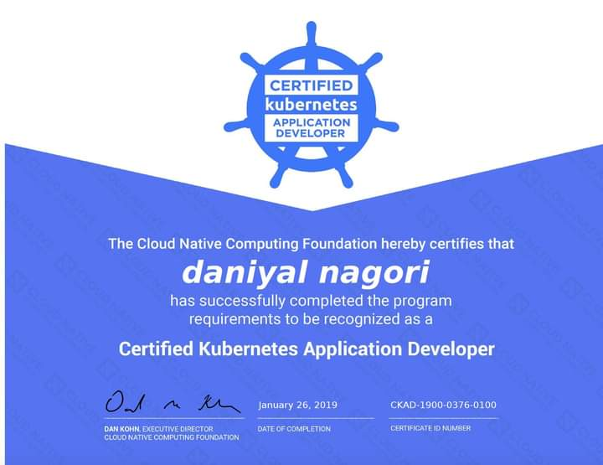


About Instructor
Notes:
https://www.credly.com/badges/c3e0f7e9-4c13-4393-91a8-42e9901e2e04/linked_in_profile
https://graduation.udacity.com/confirm/4epk27st
https://www.credly.com/badges/7f8f27e0-1dad-4011-8565-f648cb709829/linked_in_profile

Slide 4
“TypeScript is a statically/strongly typed open source programming language that builds on JavaScript, giving you better tooling at any scale.”

Slide 5
Why should you use TypeScript?
Static typing.
TypeScript is a superset of JavaScript that adds optional static typing and other features such as classes and modules.
TypeScript checks a program for errors before execution, and does so based on the kinds of values, it’s a static type checker.
Once TypeScript’s compiler is done with checking your code, it erases the types to produce the resulting “compiled” code. This means that once your code is compiled, the resulting plain JS code has no type information.
Access to latest features(ES6, ES7, etc...), before they become supported by major browsers.
Use cutting edge ECMA features such as `Optional Chaining (?.)` operator without having to worry about browser support.

Slide 6
Why should you use TypeScript?
Code completion and Intellisense
Object Oriented Programming
Its helps programmers to write code in a object oriented manner if required. Thus helps users to jump into TS
IDE Support
It is super well-supported by text editors including (VS Code, Atom, Sublime, Eclips, etc.)
Large Community/Adoption
TypeScript is made for creating large, complex systems that the modern Web abounds with.

Slide 7
TypeScript’s Popularity

Slide 8
TypeScript Is Fastest-Growing Programming Language
"TypeScript's share has almost tripled over the course of 6 years, increasing from 12 percent in 2017 to 34 percent in 2022," said the company's State of Developer Ecosystem 2022.
TypeScript passed four languages (C, PHP, C# and C++) over the past six years.
https://redmonk.com/sogrady/2021/08/05/language-rankings-6-21/
Notes:
https://visualstudiomagazine.com/articles/2023/02/02/jetbrains-survey.aspx

Slide 9
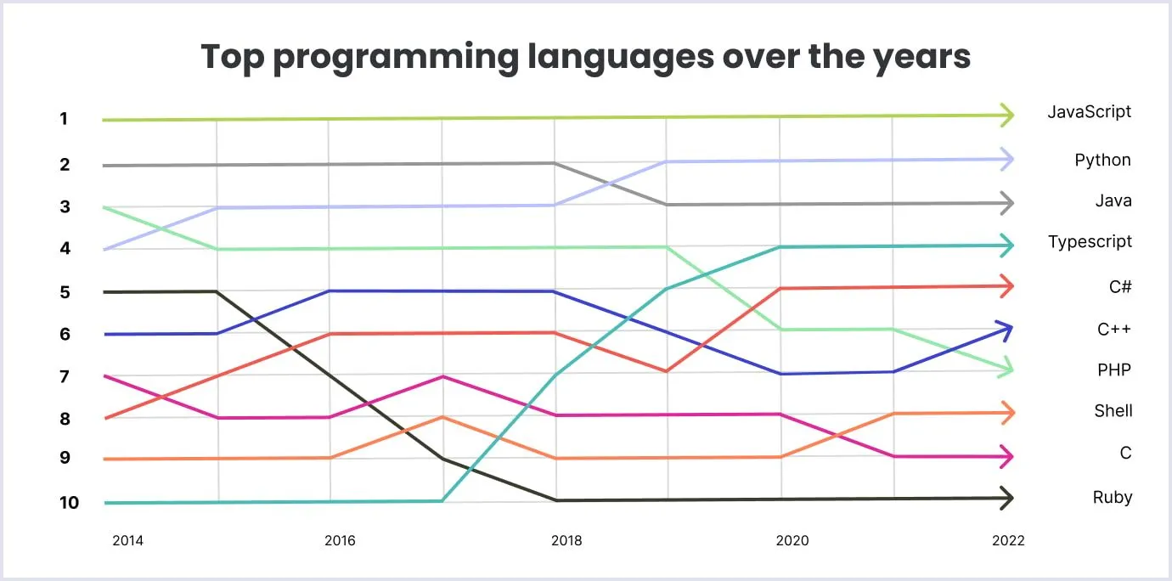
https://pypl.github.io/PYPL.html

Slide 10
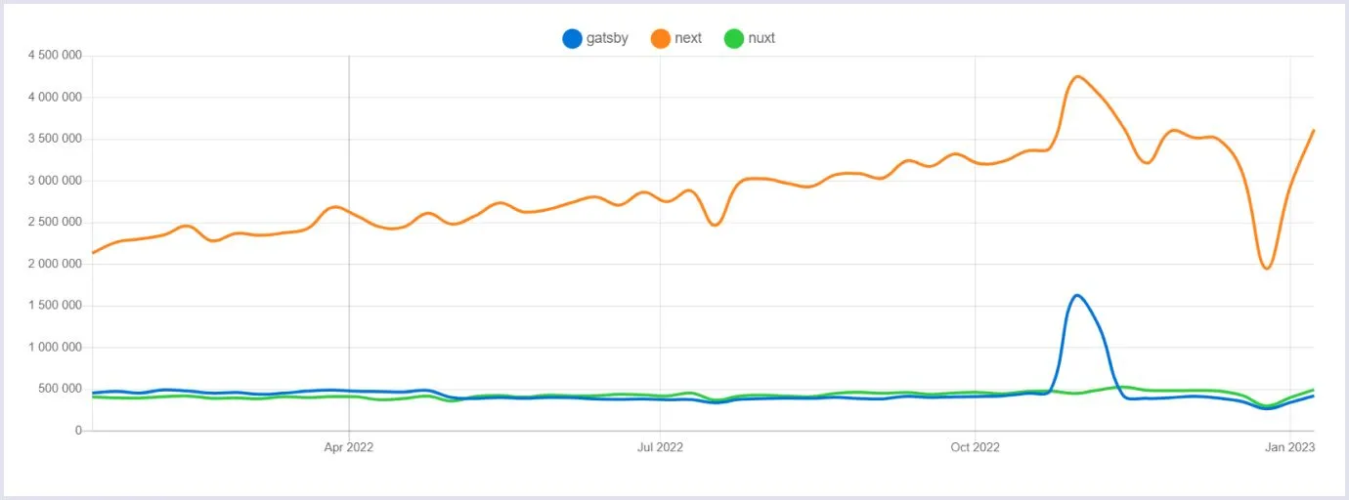
Next.js 13 Now Supports TypeScript By Default
Next.js is the Most Demanded Full Stack Framework in 2023
https://redmonk.com/sogrady/2021/08/05/language-rankings-6-21/
Notes:
https://visualstudiomagazine.com/articles/2023/02/02/jetbrains-survey.aspx

Slide 11
Getting Started

Slide 12
Setting up your environment

Slide 13
Setting up your environment
There are many ways in which you can set up a coding environment. Such as:
Integrated Development Environment (IDE). Example: VS Code, Sublime Text, Atom, etc.
Web browser. Example: Chrome, Firefox, etc.
Online editor (optional). Example: StackBlitz, Replit, etc.
Notes:
OOP = Object Oriented Programming
FP = Functional Programming

Slide 14
Install NodeJs and VS Code
https://nodejs.org/en/download/current/
Install Version 18.10.0+
node -v
https://code.visualstudio.com/

Slide 15
Install Typescript
https://www.npmjs.com/package/typescript
npm install -g typescript
tsc —init
Create a new file and name it whatever you want or better name it `index.ts` just for convention.
Open your file in any text editor like vscode, notepad etc

Slide 16
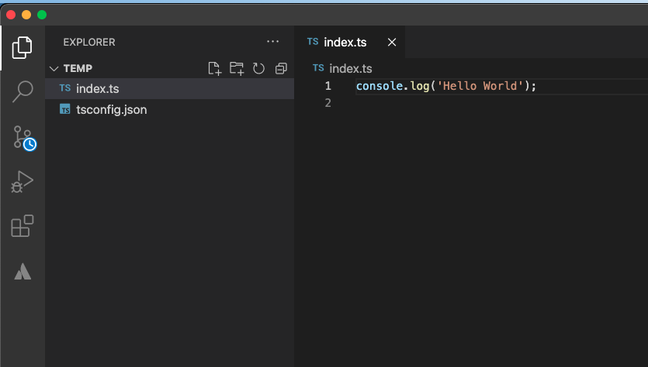
First Typescript Program
Write the following code:
console.log("Hello World");

Slide 17
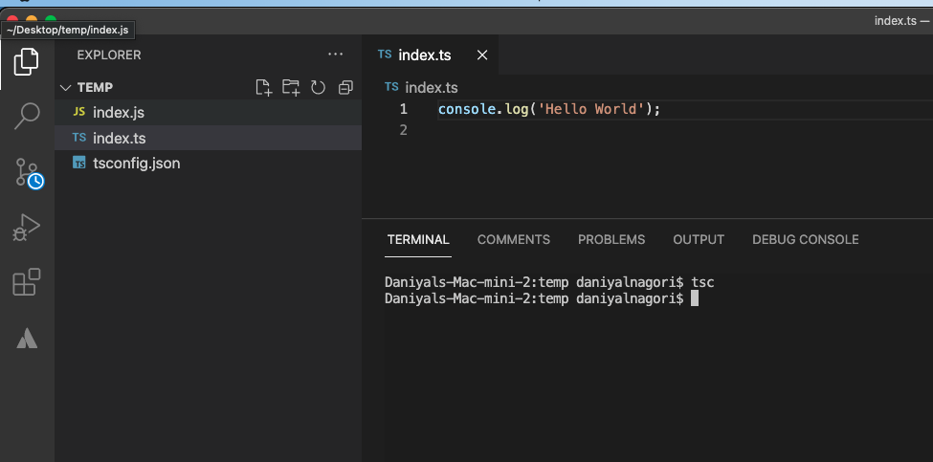
Run Typescript Program
tsc
It will compile into Javascript.

Slide 18
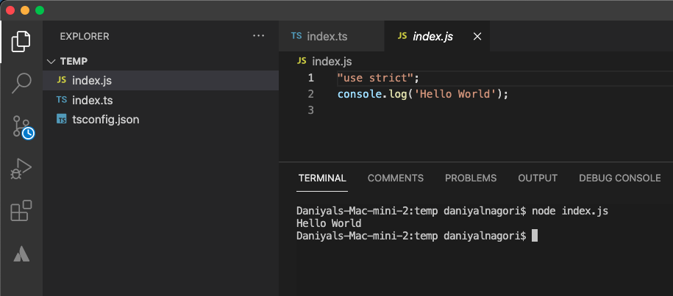
Run Typescript Output
node index.js
You will see the output inside
the terminal.

Slide 19
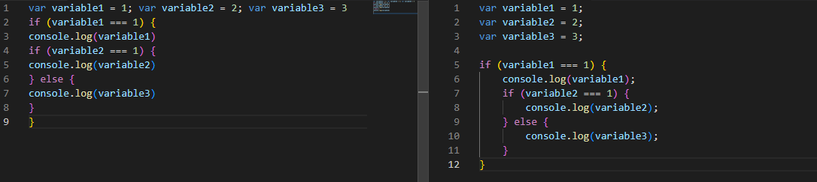
Writing code
Formatting code:
Code needs to be formatted well. If you have a long file with many lines of code and you didn't stick to a few basic formatting rules, it is going to be hard to understand what you've written.
The two most important rules for formatting the code are indentations and semicolons.
Notes:
OOP = Object Oriented Programming
FP = Functional Programming

Slide 20
Fundamentals

Slide 21
Variables

Slide 22
Variables
Variable means anything that can vary.
A TypeScript variable is simply a name of storage location.
A variable must have a unique name.
Notes:
OOP = Object Oriented Programming
FP = Functional Programming

Slide 23
Variables
Variables are values in your code that can represent different values each time the code runs.
The first time you create a variable, you declare it. And you need a special word for that: let , var , or const . Example: let firstname = "Ali";
The commonly used naming conventions used for variables are camel-case. Example: let firstName = "Ali";
Notes:
OOP = Object Oriented Programming
FP = Functional Programming

Slide 24
Variables Names
﻿A variable name can't contain any spaces
﻿﻿﻿A variable name can contain only letters, numbers, dollar signs, and underscores.
The first character must be a letter, or an underscore (-), or a dollar sign ($).
﻿﻿﻿Subsequent characters may be letters, digits, underscores, or dollar signs.
Numbers are not allowed as the first character of variable.
Notes:
OOP = Object Oriented Programming
FP = Functional Programming

Slide 25
Type Annotations on Variables
When you declare a variable using const, var, or let you can optionally add a type annotation to explicitly specify the type of the variable:
let myName: string = "Alice";
TypeScript doesn’t use “types on the left”-style declarations like int x = 0; Type annotations will always go after the thing being typed.
In most cases, though, this isn’t needed. Wherever possible, TypeScript tries to automatically infer the types in your code.
// No type annotation needed -- 'myName' inferred as type 'string'
let myName = "Alice";
Notes:
OOP = Object Oriented Programming
FP = Functional Programming

Slide 26
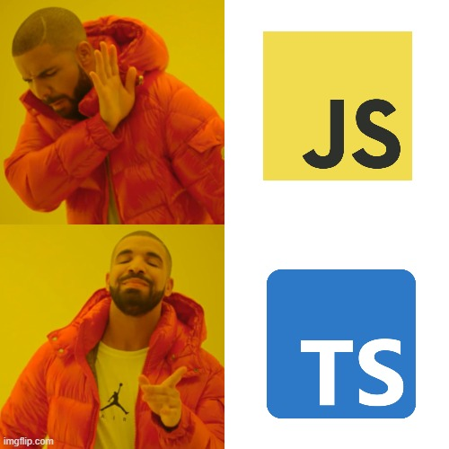
Why Choose TypeScript over JavaScript?
TypeScript enhances JavaScript by offering type safety, improved code readability, better tooling support, and advanced programming features, making it a robust choice for scalable and maintainable web developmentrs at compile-time rather than at runtime.
Notes:
OOP = Object Oriented Programming
FP = Functional Programming

Slide 27
Comments
Single line TypeScript comments start with two forward slashes (//).
All text after the two forward slashes until the end of a line makes up a comment
Even when there are forward slashes in the commented text.
Multi-line Comments
Multi-line comments start with /* and end with */.
Any text between /* and */ will be ignored by JavaScript.
Notes:
OOP = Object Oriented Programming
FP = Functional Programming

Slide 28
Statements
A computer program is a list of "instructions" to be "executed" by a computer.
In a programming language, these programming instructions are called statements.
A JavaScript program is a list of programming statements.
TypeScript applications consist of statements with an appropriate syntax. A single statement may span multiple lines. Multiple statements may occur on a single line if each statement is separated by a semicolon.
Notes:
OOP = Object Oriented Programming
FP = Functional Programming

Slide 29
Let, Var, Const
var and let are both used for variable declaration in TypeScript but the difference between them is that var is function scoped and let is block scoped. Variable declared by let cannot be redeclared and must be declared before use whereas variables declared with var keyword are hoisted.
const is an augmentation of let in that it prevents re-assignment to a variable.
Dont use var, use let and const
Notes:
OOP = Object Oriented Programming
FP = Functional Programming

Slide 30
Primitive data types

Slide 31
Primitive data types
String
A string is used to store a text value. Example: let firstName = "Ali";
Number
A number is used to store a numeric value. Example: let score = 25;
Boolean
A boolean is used to store a value that is either true or false. Example: let isMarried = false;
Undefined
An undefined type is either when it has not been defined or it has not been assigned a value. Example: let unassigned;
Null
null is a special value for saying that a variable is empty or has an unknown value. Example: let empty = null;
Notes:
OOP = Object Oriented Programming
FP = Functional Programming

Slide 32
Template Literals
A new and fast way to deal with strings is Template Literals or Template String.
How we were dealing with strings before ?
var myName = "daniyal" ;
var hello = "Hello "+ myName ;
console.log(hello); //Hello daniyal
Notes:
OOP = Object Oriented Programming
FP = Functional Programming

Slide 33
Template Literals
What is Template literals ?
As we mentioned before , it’s a way to deal with strings and specially dynamic strings ; so you don’t need to think more about what’s the next quote to use single or double.
How to use Template literals
It uses a `backticks` to write string within it.
Notes:
OOP = Object Oriented Programming
FP = Functional Programming

Slide 34
Analyzing and modifying data types

Slide 35
Analyzing and modifying data types
You can check the type of a variable by entering typeof. Example: let testVariable = 1; console.log(typeof testVariable);
The variables in TypeScript cannot change types. Example: let a = 2; a = “2”; //Error
Notes:
OOP = Object Oriented Programming
FP = Functional Programming

Slide 36
Operators

Slide 37
Operators
Arithmetic operators:
Addition Example:
let n1 = 1; let n2 = 2; console.log(n1 + n2); // ?
let str1 = “1”; let str2 = “2”; console.log(str1 + str2); // ?
Notes:
OOP = Object Oriented Programming
FP = Functional Programming

Slide 38
Operators
Arithmetic operators:
Subtraction Example:
let n1 = 5; let n2 = 2; console.log(n1 - n2); // ?
Multiplication Example:
let n1 = 5; let n2 = 2; console.log(n1 * n2); // ?
Notes:
OOP = Object Oriented Programming
FP = Functional Programming

Slide 39
Operators
Arithmetic operators:
Division Example:
let n1 = 4; let n2 = 2; console.log(n1 / n2); // ?
Exponentiation Example:
let n1 = 2; let n2 = 2; console.log(n1 ** n2); // ?
Notes:
OOP = Object Oriented Programming
FP = Functional Programming

Slide 40
Operators
Arithmetic operators:
Modulus Example:
let n1 = 10; let n2 = 3; console.log(n1 % n2); // ?
Notes:
OOP = Object Oriented Programming
FP = Functional Programming

Slide 41
Operators
Assignment operators:
Assignment operator are used to assigning values to variables. Example:
let n = 5; console.log(n); // 5 n += 5; console.log(n); // 10 n -= 5; console.log(n); // 5
Notes:
OOP = Object Oriented Programming
FP = Functional Programming

Slide 42
Operators
Comparison operators:
Comparison operator are used to compare values of variables. Example:
let n = 5; console.log(n == 5); // console.log(n === 5); // console.log(n != 5); // console.log(n > 8); // console.log(n < 8); // console.log(n >= 8); // console.log(n <= 8); //
Notes:
OOP = Object Oriented Programming
FP = Functional Programming

Slide 43
Operators
Logical operators:
Logical operator are used to combine multiple conditions in one. Example:
let n = 5; console.log(n >= 5 && n < 10); // console.log(n > 5 && n < 10); // console.log(n >= 5 || n < 10); // console.log(n > 5 || n < 10); // console.log(!(n < 10)); // console.log(!(n > 10)); //
Notes:
OOP = Object Oriented Programming
FP = Functional Programming

Slide 44
If, Else, Else If Statements

Slide 45
If, Else and Else If Statements
Use if to specify a block of code to be executed, if a specified condition is true.
Use else to specify a block of code to be executed, if the same condition is false.
Use else if to specify a new condition to test, if the first condition is false.

Slide 46
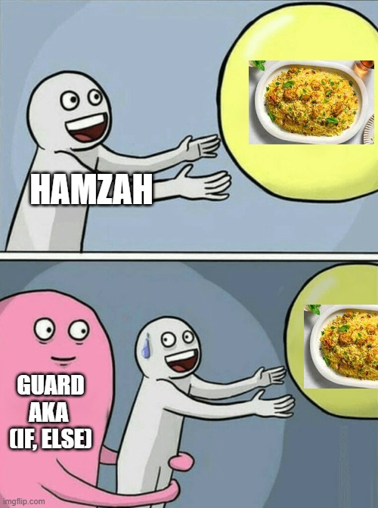
If, Else and Else If Statements - Examples 1
let myName = "Hamzah";
if (myName == "Hamzah") {
console.log("Hamzah is not allowed for the biryani party")
} else {
console.log("You are allowed for the biryani party")
}

Slide 47
If, Else and Else If Statements - Examples 2
If Example:
let x = prompt("Where does the Pope live?"); let correctAnswer = "Pakistan"; if (x == correctAnswer ) { console.log("Correct!"); }
else - Example
let x = prompt("Where does the Pope live?"); let correctAnswer = "Pakistan"; if (x == correctAnswer ) { console.log("Correct!"); } else { console.log("Wrong!"); }

Slide 48
If, Else and Else If Statements - Examples
Else if - Example
let x = prompt("Where does the Pope live?"); let correctAnswer = "Pakistan"; if (x == correctAnswer ) { console.log("Correct!"); } else if (x=="Pakista") { console.log("Close!"); } else { console.log("Wrong!"); }

Slide 49
If Statement Nested

Slide 50
If Statement Nested
JavaScript allows us to nest if statements within if statements. i.e, we can place an if statement inside another if statement.

Slide 51
If Statement Nested - Example
// Ticketing system
let country = "pakistan"
// Number() function is used to convert the string to number
let age = 10
if (country === "pakistan") {
if (age >= 18) {
console.log("Here is your ticket")
} else {
console.error("Age restriction")
}
} else {
console.log("Invalid country")
}

Slide 52
Functions

Slide 53
Functions
Functions are the primary means of passing data around in TypeScript. TypeScript allows you to specify the types of both the input and output values of functions.
// Parameter type annotation
function greet(name: string) {
console.log("Hello, " + name.toUpperCase() + "!!");
}
Notes:
https://www.typescriptlang.org/docs/handbook/2/everyday-types.html#functions
https://www.typescriptlang.org/docs/handbook/2/functions.html

Slide 54
Return Type Annotations
You can also add return type annotations. Return type annotations appear after the parameter list:
function getFavoriteNumber(): number {
return 26;
}
Much like variable type annotations, you usually don’t need a return type annotation because TypeScript will infer the function’s return type based on its return statements.
Notes:
https://www.typescriptlang.org/docs/handbook/2/everyday-types.html#functions
https://www.typescriptlang.org/docs/handbook/2/functions.html

Slide 55
Arrow Functions
let sum1 = (x: number, y: number): number => {
return x + y;
}
sum1(10, 20); //returns 30
let sum2 = (x: number, y: number) => x + y;//can skip return
sum2(3, 4); //returns 7

Slide 56
Array

Slide 57
Array
The Problem: Suppose you have five fruits and you want to store them in the variable, But you have to create five variables to store the fruits which is not an efficient approach, what if you have thousands of fruits?
let fruit1 = "apple" let fruit2 = "banana" let fruit3 = "grapes" let fruit4 = "strawberry" let fruit5 = "orange"
The Solution: Here the array comes into play which helps to store multiple data in a single variable.
let fruits = ["apple","banana", "orange", "grapes", "strawberry"]

Slide 58
Array - More About Array
An array is a special variable, which can hold more than one value.
An array can hold many values under a single name, and you can access the values by referring to an index number.
In JavaScript, arrays always use numbered indexes.
Array indexes start with 0.
Examples:
let fruits = ["apple","banana", "orange", "grapes", "strawberry"] fruits[0] // apple fruits[3] // grapes
let x = [1, 2, "daniyal"] // Arrays can store multiple types of data

Slide 59
Arrays: Adding and removing elements

Slide 60
Arrays: Adding and removing elements
When you work with arrays, it is easy to remove elements and add new elements. This is what popping and pushing is.
The pop() method removes the last element from an array:
The pop() method returns the value that was "popped out"
The push() method adds a new element to an array (at the end).
The push() method returns the new array length.

Slide 61
Arrays: Adding and removing elements - Examples
var pets = []; pets[0] = "dog"; // adds “dog” to an array at 0 index pets[1] = "cat"; // adds “cat” to an array at index 1 pets.pop(); // removes the last element of an array which is cat in our case pets.push("parrot"); // adds a new element to an array

Slide 62
Arrays: Removing, inserting, and extracting elements

Slide 63
Arrays: Removing, inserting, and extracting elements
Shifting is equivalent to popping, but working on the first element instead of the last.
The shift() method removes the first array element and "shifts" all other elements to a lower index.
The shift() method returns the value that was "shifted out".
The unshift() method adds a new element to an array (at the beginning), and "unshifts" older elements:
The unshift() method returns the new array length.

Slide 64
Arrays: Removing, inserting, and extracting elements - Example
var pets = []; pets[0] = "dog"; // adds “dog” to an array at 0 index pets[1] = "cat"; // adds “cat” to an array at index 1 pets.shift(); // removes the first element of an array which is cat in our case pets.unshift("parrot"); // adds a new element to an array (at the beginning)

Slide 65
Arrays: Removing, inserting, and extracting elements
Splicing and Slicing Arrays
The splice() method adds new items to an array.
Example: const fruits = ["Banana", "Orange", "Apple", "Mango"]; fruits.splice(2, 0, "Lemon", "Kiwi"); // adds elements to an array at 2nd index // deleted 0 elements
The slice() method slices out a piece of an array.
Example: const fruits = ["Banana", "Orange", "Lemon", "Apple", "Mango"]; const citrus = fruits.slice(1); // [Orange,Lemon,Apple,Mango]
Notes: The slice() method creates a new array.

Slide 66
For Loops

Slide 67
For Loops
Loops are handy, if you want to run the same code over and over again, each time with a different value.
// Syntax:
for (expression 1; expression 2; expression 3) {
// code block to be executed
}
From the example above, you can read
Expression 1 sets a variable before the loop starts (let i = 0).
Expression 2 defines the condition for the loop to run (i must be less than 5).
Expression 3 increases a value (i++) each time the code block in the loop has been executed.

Slide 68
For Loops - Examples
Example 1
for (let i = 0; i < 3; i++) {
console.log("Hello World")
}
Example 2
for (let i = 0; i < 3; i++) {
console.log("Hello World" + i)
}

Slide 69
For Loops - Examples
Example 3
var cleanestCities = ["Karachi", "Lahore", "Islamabad", "Peshawar"];
for (var i = 0; i <= 4; i++) {
if ("Islamabad" === cleanestCities[i]) {
console.log("It's one of the cleanest cities");
break;
}
}

Slide 70
For Loops - Examples
Example 4
var cleanestCities = ["Karachi", "Lahore", "Islamabad", "Peshawar"];
var matchFound = "no";
for (var i = 0; i <= 4; i++){
if ("Islambad" === cleanestCities[i]) {
matchFound = "yes";
alert("It's one of the cleanest cities");
}
}
if (matchFound === "no") {
alert("It's not on the list");
}

Slide 71
For Loops - Examples
Example 5
var cleanestCities = ["Karachi", "Lahore", "Islamabad", "Peshawar"];
var numElements = cleanestCities.length;
var matchFound = false;
for (var i = 0; i < numElements; i++) {
if ("Islamabad" === cleanestCities[i]) {
matchFound = true;
console.log("It's one of the cleanest cities");
break;
}
}
if (matchFound === false) {
console.log("It's not on the list");
}

Slide 72
Nested For Loops

Slide 73
Nested For Loops - Example
A nested loop is a loop within a loop.
var firstNames = ["BlueRay ", "Upchuck ", "Lojack ", "Gizmo ", "Do-Rag "];
var lastNames = ["Zzz", "Burp", "Dogbone", "Droop"];
var fullNames = [];
for (var i = 0; i < firstNames.length; i++) {
for (var j = 0; j < lastNames.length; j++) {
fullNames.push(firstNames[i] + lastNames[j]);
}
}

Slide 74
Advanced TypeScript
https://github.com/panaverse/learn-typescript

Slide 75
Thank You
Start Working on Getting Started Exercises with TypeScript and Node.js
https://github.com/panaverse/typescript-node-projects/blob/main/getting-started-exercises.md
Advanced TypeScript:
https://github.com/panaverse/learn-typescript

